Slide 1
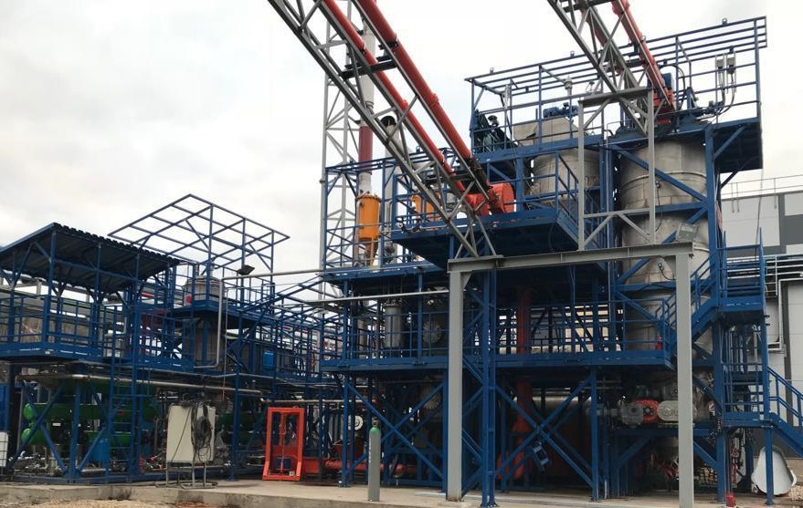
Technical Corporate GROUP AURORA BOREALIS and MPM Steel
Slovak Republic
info@auroraborealis.group
Complex for the recovery of used plastic,
hydrocarbon waste, other plastic waste
using the equipment of Thermochemical Destruction
productivity up to 20,000 tons of plastic waste per year
To: Veolia
2023

Slide 2
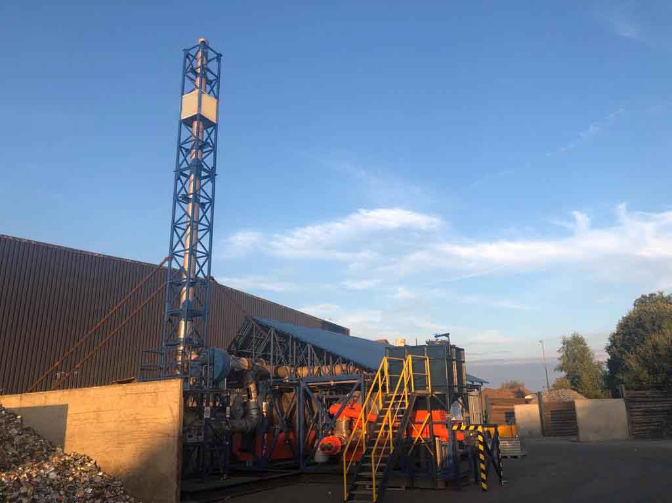
Technical Corporate GROUP AURORA BOREALIS and MPM Steel
Slovak Republic
TDP equipment is the set of equipment that provide recovery of 20,000 tons of plastic waste per year or up to 2.5 tons of plastic waste per hour, using the method of thermochemical destruction, that is, decomposition of various types of waste into low-molecular components without oxygen.
TDP equipment for the recovery of plastic waste, hydrocarbon waste, operates in a continuous mode, has several types and capacities.
Our equipment:
recovers different types of waste;
produces recovered products from waste;
produces synthetic liquid hydrocarbons from waste;
produces synthetic hydrocarbon gas from waste;
generates electrical energy from waste;
produces hydrogen from waste.
TDP equipment is controlled from the operator's console.
To control the technological parameters of the TDP equipment, instrumentation and automation are installed.

Slide 3
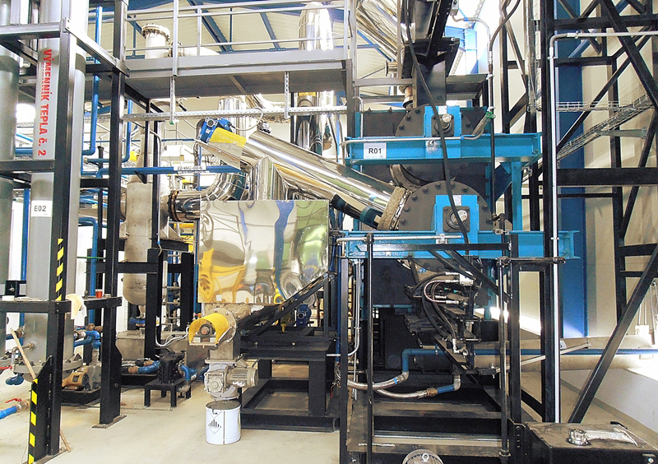
Technical Corporate GROUP AURORA BOREALIS and MPM Steel
Slovak Republic
Description of the Used Plastic Recovery Process
Used plastic accumulates in a storage container. Then, this used plastic is specially prepared (know-how) for use in a thermochemical reactor.
The prepared used plastic is fed into the thermochemical reactor by an automatic screw. The design of a thermochemical reactor is Know-How. Inside the thermochemical reactor, the used plastic is moved by screws at a certain angle and at a calculated speed (know-how). Inside the thermochemical reactor, the used plastic is gradually heated without oxygen. The stages of heating the used plastic inside the thermochemical reactor and the temperature at these points depend on the morphology of the used plastic and the chemical composition of the used plastic.
Inside the thermochemical reactor, thermal decomposition (destruction) of the used plastic takes place with a phased release of the gas mixture. To obtain recovered liquid hydrocarbons, the temperature at the points of the reactor ranges from 150°C to 480°C. To obtain recovered gas, the temperature at the points of the reactor ranges from 190 °C to 650 °C. Heating is carried out with the help of thermal energy, which is obtained from gas burners and liquid fuel burners, and which is transferred to the reactor.
The burners use synthetic gas or liquid hydrocarbons, which are synthesized during a thermochemical reaction.

Slide 4
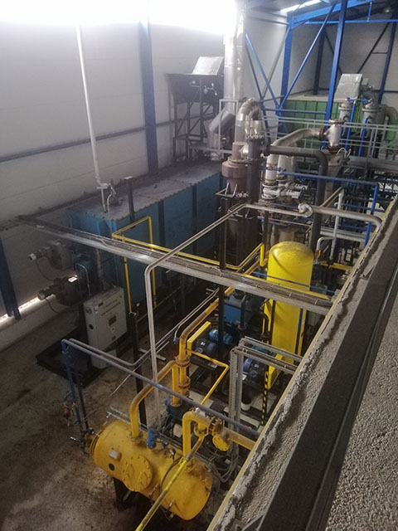
Technical Corporate GROUP AURORA BOREALIS and MPM Steel
Slovak Republic
The gas mixture from the thermochemical reactor enters the separation unit (know-how), in which long hydrocarbon chains (paraffins) are returned to the thermochemical reactor for re-destruction and recovery.
From the separation unit, the gas mixture enters the gas purification unit and the gas drying unit. Next to the condensation system.
Depending on the customer's requirements, the condensation unit can produce liquid hydrocarbons of the same density or different densities (distillation column).
After the condensation unit, the condensation products enter the gas-liquid separator, where the liquid fraction and gaseous fractions are separated. The liquid fraction enters the storage tanks, and the synthesis gas enters the gas drying column. After the gas drying column, the synthesis gas enters the water seal unit.
The purified and recovered gas is fed into the gas receiver for storage.
Part of this gas and liquid hydrocarbons (up to 15%) is used to heat the thermochemical reactor.
The recovered gas can be used to produce hydrogen, generate electricity.
Recovered liquid hydrocarbons from the storage tank are periodically pumped to the storage of finished products.
The unloading of recovered carbon black (rCB) from the reactor is carried out continuously using an automated screw.

Slide 5
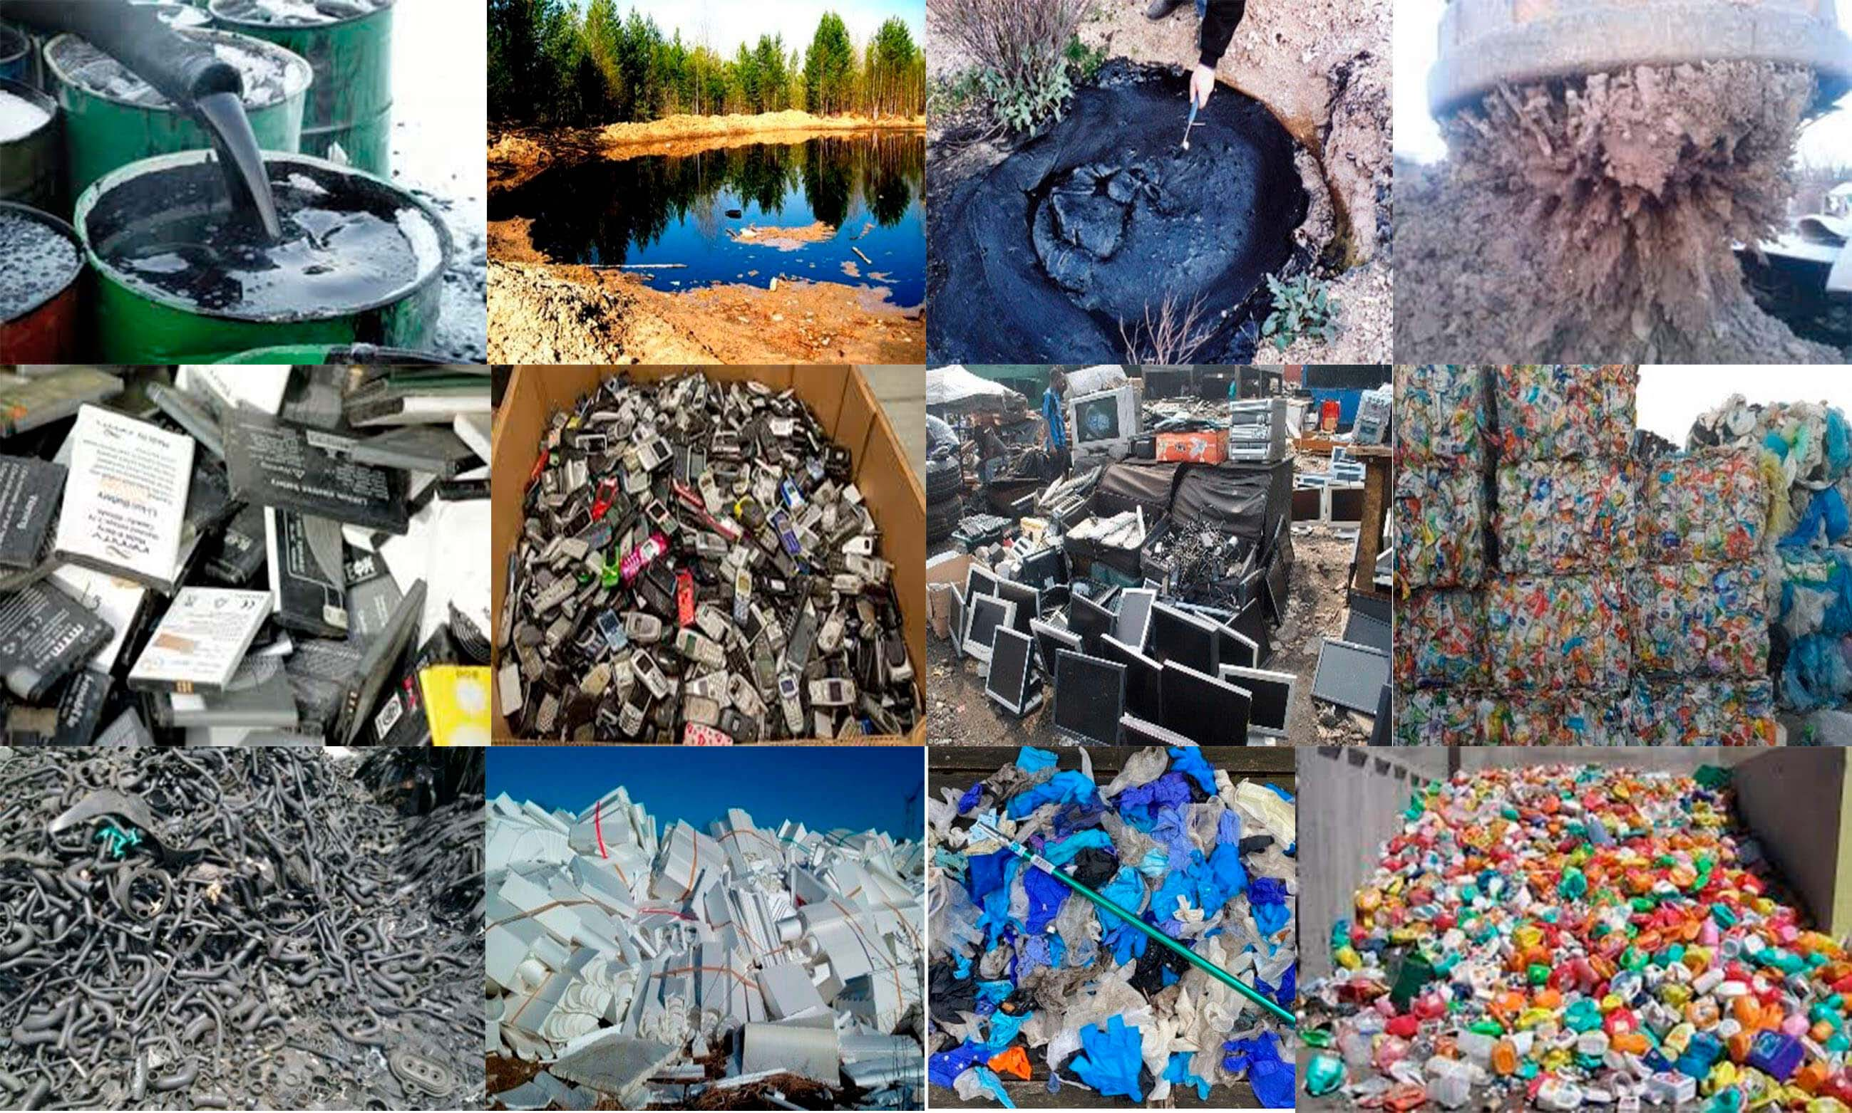
Technical Corporate GROUP AURORA BOREALIS and MPM Steel
Slovak Republic
USE OF TECHNOLOGY
TDP equipment can recover the following wastes:
 | Electrotechnical |  | Plastic, polyethylene, film
 | E-waste phones, electronic boards, tablets, monitors, televisions, computers, used printer cartridges and more |  | Waste of industrial rubber goods car tires, rubber insulators, conveyor belts, other rubber products
 | Battery |  | Insulation materials
 | Solid state batteries |  | Expanded polystyrene, polystyrene
 | CDs, audio drives, floppy disks |  | Acid tars, acid sludge, waste from oil refineries
 |  |  | Oil sludge
 | Telephone cable, electrical cable |  | Drill cuttings
 | Medical waste syringes, dropper systems, gloves, shoe covers, masks |  | Rubber personal protective equipment, including for employees of nuclear power plants gas masks, overalls, boots, gloves
 | Medicines
 | Hard paraffins |  | Used oil
 | Waste from paint and varnish production |  | Oiled Scale at metallurgical plants
 | Coals, coal tar |  | Water contaminated with oil and oil products

Slide 6
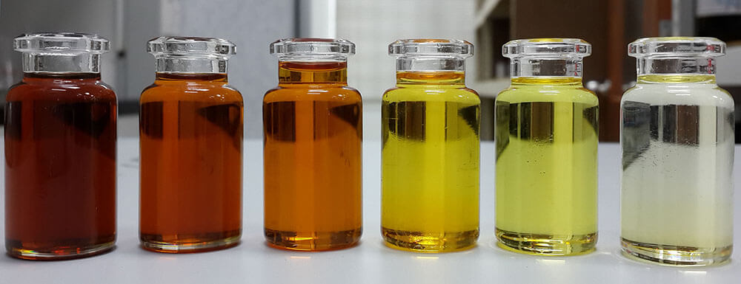
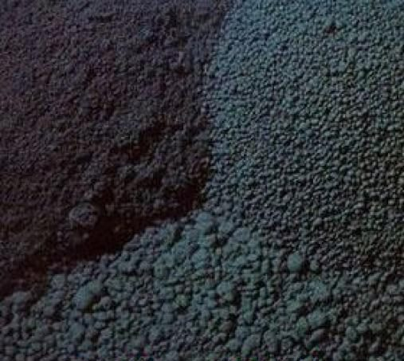
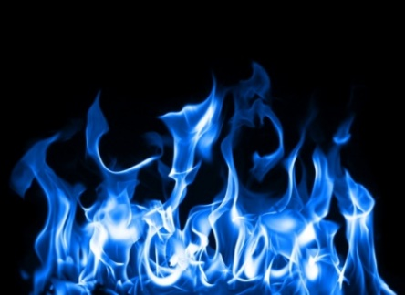
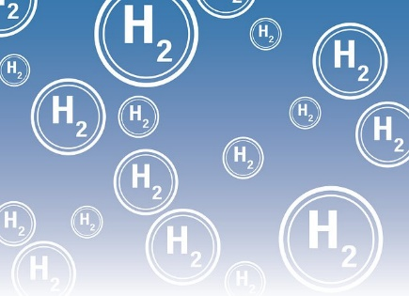
Technical Corporate GROUP AURORA BOREALIS and MPM Steel
Slovak Republic
After waste recovery
After the recovery of hydrocarbon waste, a product group is produced, which is:
Liquid hydrocarbon
The chemical composition depends on the type of waste and is a mixture of liquid hydrocarbons from which can get:
gasoline, diesel fuel, kerosene, ethers, solvents, benzenes and more.
Liquid hydrocarbons can be used for:
refineries as a substitute for fossil fuels;
petrochemical enterprises as a substitute for fossil raw materials;
production of electrical energy.
Hydrocarbon gas
The composition of the gas depends on the type of waste and is a mixture of hydrocarbon gases such as hydrogen, methane, ethane and other gases..
Hydrocarbon gas can be used for:
production of hydrogen;
production of other gases;
electricity generation.
Ash residue
The chemical composition depends on the type of waste and is:
carbon;
inorganic compounds, depending on the type of waste.
Сan make from carbon:
activated carbon;
filters;
recovered Carbon Black (rCB).

Slide 7
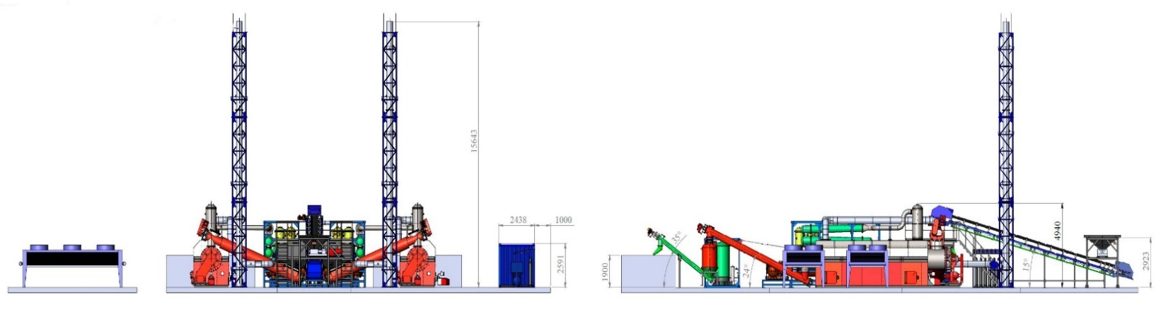
Technical Corporate GROUP AURORA BOREALIS and MPM Steel
Slovak Republic
Technical characteristics of TDP equipment for plastic waste recovery up to 20,000 tons per year
Name of parameters | Values
Nominal equipment performance | 2.5 tons per hour 20 000 tons per year
Operation mode | Continuous
Fuel consumption for equipment operation
- liquid hydrocarbons, from TDP equipment, liter per hour | up to 70
- hydrocarbon gas, from equipment TDP, m³ per hour | up to 120
Minimum area for placing TDP- equipment, m² | 1600
Maximum temperature inside the reactor, °С | 650
Voltage | 380
Phases | 3Р
Frequency, Hz | 50
Maximum power consumption, kW / hour for 1 hour of operation | 180
Minimum temperature of flue gases from the chimney, °С | 120

Slide 8
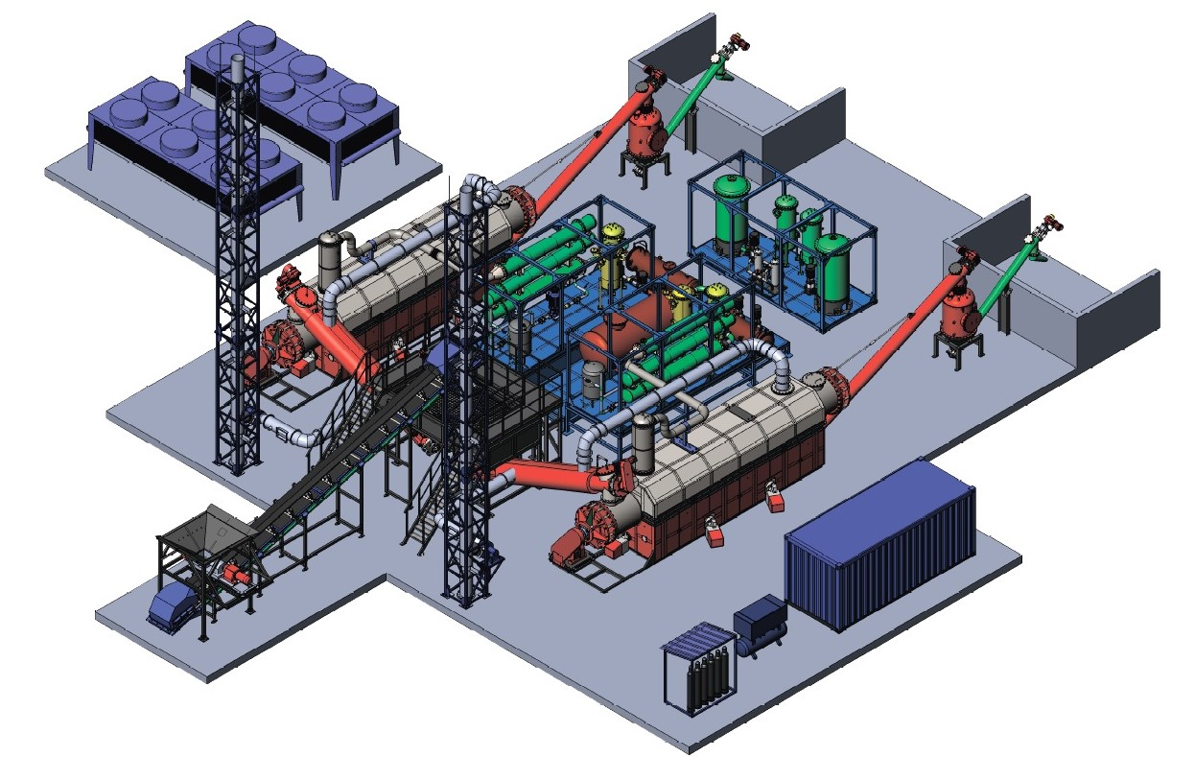
The TDP equipment package consists of
Technical Corporate GROUP AURORA BOREALIS and MPM Steel
Slovak Republic
No | Name | number
1 | Thermochemical reactor TDP, complete and ready for operation | 2
2 | Unit for waste accumulation and waste loading | 4
3 | Belt conveyor for transporting waste | 2
4 | Unloading, cooling and ash accumulation unit | 2
5 | Chimney | 2
6 | Vapor-gas mixture condensation unit | 2
7 | Gas purification unit | 2
8 | Process water purification unit | 2
9 | Filtration unit | 2
10 | Liquid hydrocarbon collection and purification unit | 2
11 | Operator unit and switchboard | 1
12 | Unit for cooling of coolant | 2
13 | Compressed air production unit | 2
14 | Nitrogen production unit | 2
15 | Power connection block | 1
16 | Automation panel | 1

Slide 9
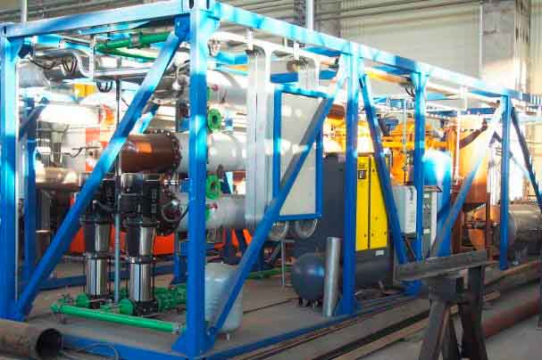
Technical Corporate GROUP AURORA BOREALIS and MPM Steel
Slovak Republic
The TDP equipment is completed with instrumentation and control
Controller | Mitsubishi Electric
Pressure meters | Mitsubishi Electric
temperature sensors | Mitsubishi Electric
Operator's panel | Weintek
level | Mitsubishi Electric
Frequency converters | Mitsubishi Electric
Electric motors | Mitsubishi Electric

Slide 10
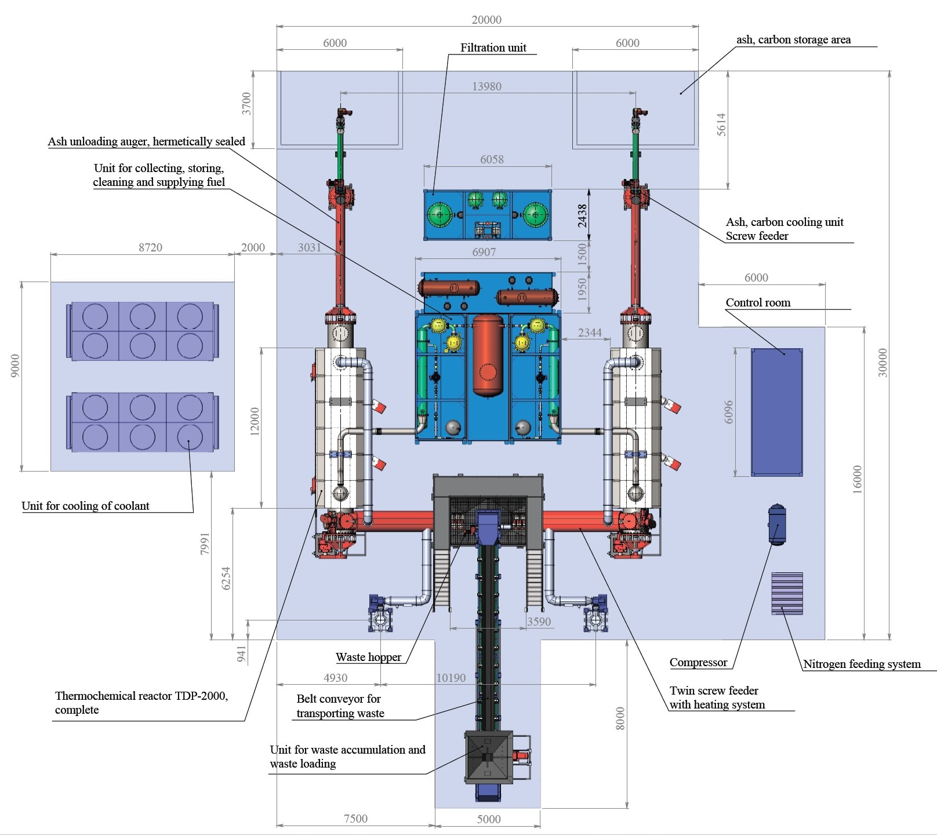
Technical Corporate GROUP AURORA BOREALIS and MPM Steel
Slovak Republic
Manufacturing time, guarantee, service
Manufacturing time for the TDP Duplex Equipment is 8 months
The warranty period from the date of transfer to the buyer is 12 months
Service - 20 years *
* service can only be carried out by the manufacturer

